Slide 1

Should you buy an All-Electric car(BEV) or Plug-in-hybrid(PHEV) in the state of Washington, USA?
By: Esha Patel, Jeff Morgan, Ipsita Pattanaik, Smita Shah, Neil Lawren

Slide 2
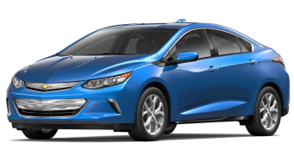
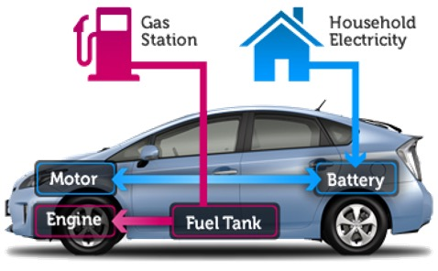
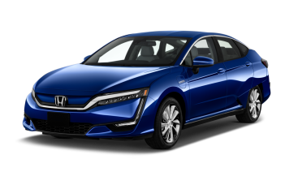
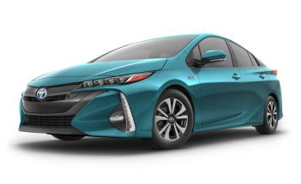
PHEV: Plug-in Hybrid Electric Vehicle
EREV
PHEV
Battery Charged using Electricity
Electricity accessed through Plug
PEV
How do they work?
Chevy Volt
Gas-fueled Internal Combustion Engine when Battery Depleted
Honda Clarity PHEV
Battery powers Electric Motor
Enough Battery for Short ALL-ELECTRIC Trips
Toyota Prius Prime

Slide 3
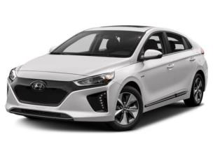
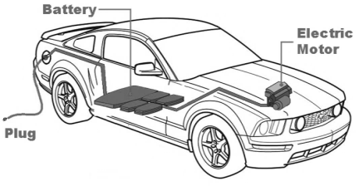
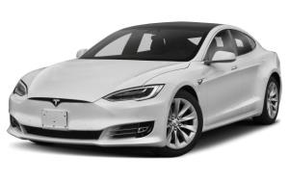
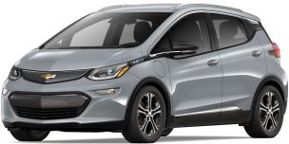
BEV: Battery Electric Vehicles
BEV
How do they work?
PEV
Battery charged using Electricity
Nissan
Electricity accessed through Plug
Tesla
Battery powers Electric Motor
Chevy

Slide 4
Data Sources Used
https://rapidapi.com/letscrape-6bRBa3QguO5/api/ev-charge-finder
- Charging Location
https://fueleconomy.gov/feg/tax2023.shtml
- Tax Incentives 2023
https://catalog.data.gov/dataset/electric-vehicle-population-data
- Washington State Data

Slide 5

FAQ about EV
Are electric vehicles affordable?
Is charging an EV cheaper than buying gas?
How and where would I charge an EV?
What type of EV is the best for me?
Should I buy new or used? Or is it better to lease?
Will an EV go enough miles between “fill-ups”?
Is an EV right for me ?

Slide 6

3 Questions Asked
QUESTION 3
What are the top popular car models for all 5 cities?
Do the most popular car models in the selected cities have federal rebate?
QUESTION 2
What is the ratio of cars to chargers in the selected cities?
What is the speed for all the chargers in top 5 cities?
QUESTION 1
Which cities in Washington have the most electric and hybrid cars registered?

Slide 7
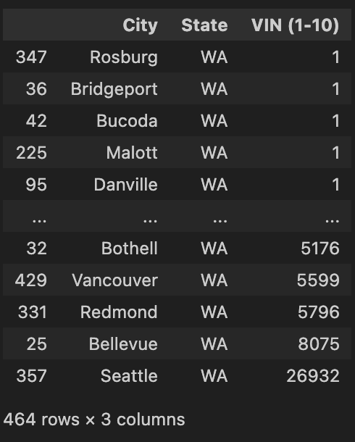
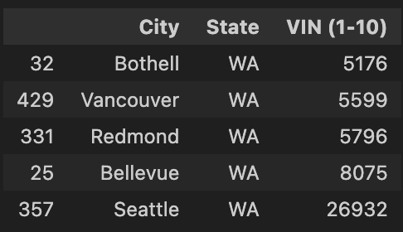
Question 1: Which cities in Washington have the most electric and hybrid cars registered?
We have total 159106 rows of data for Washington State.
We did group by city and state and counted the VIN(1-10) which provided us with 464 rows with total count of All-Electric Vehicles and Plug-in-hybrid vehicles.
We wanted to compare top 5 cities with the most data on EVs so we got the following cities: Bothell, Vancouver Redmond, Bellevue, Seattle

Slide 8
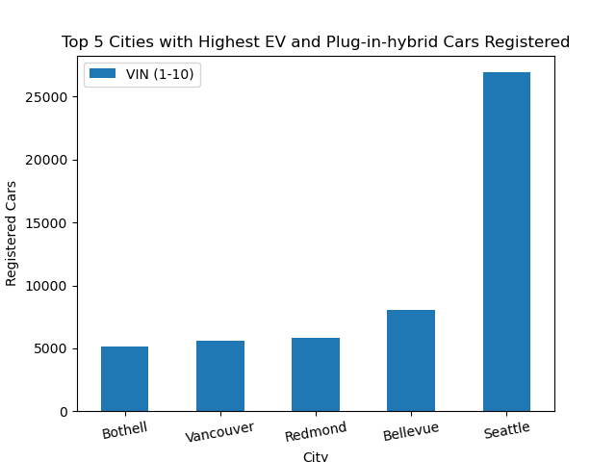
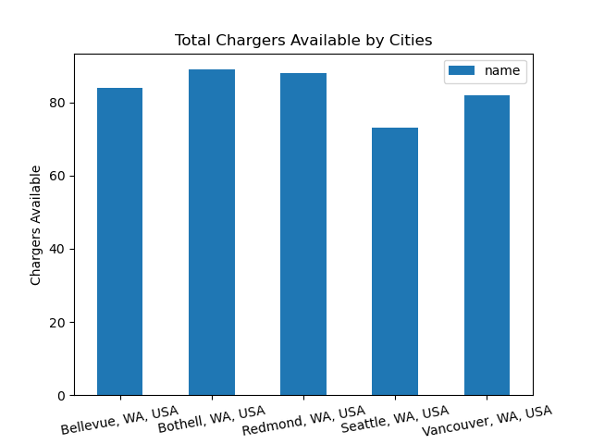
The graph below shows total chargers available for each of our top 5 cities.
The graph above shows our top 5 cities and the total registered cars per city.

Slide 9
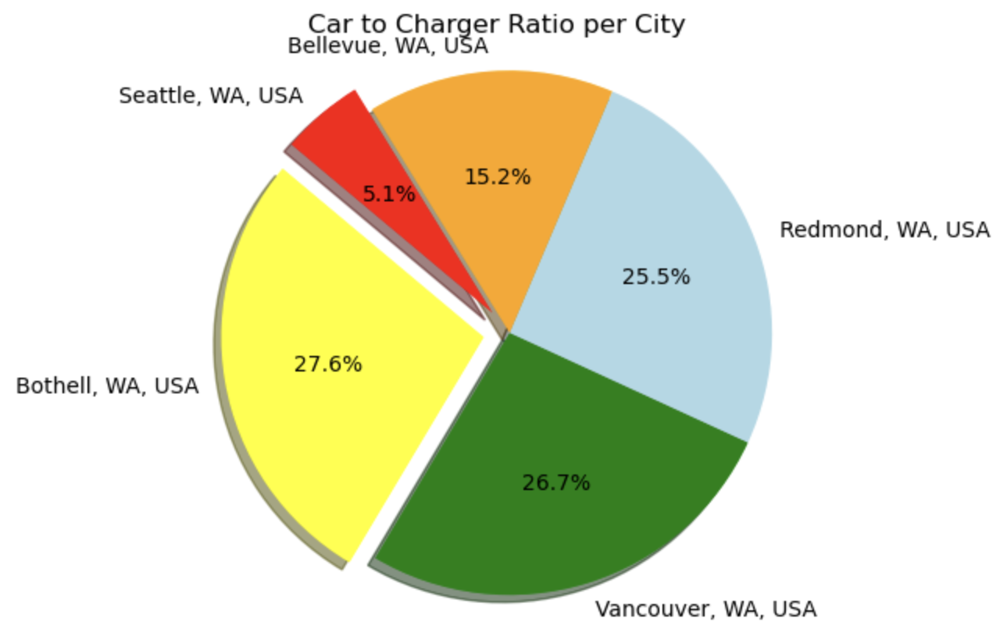
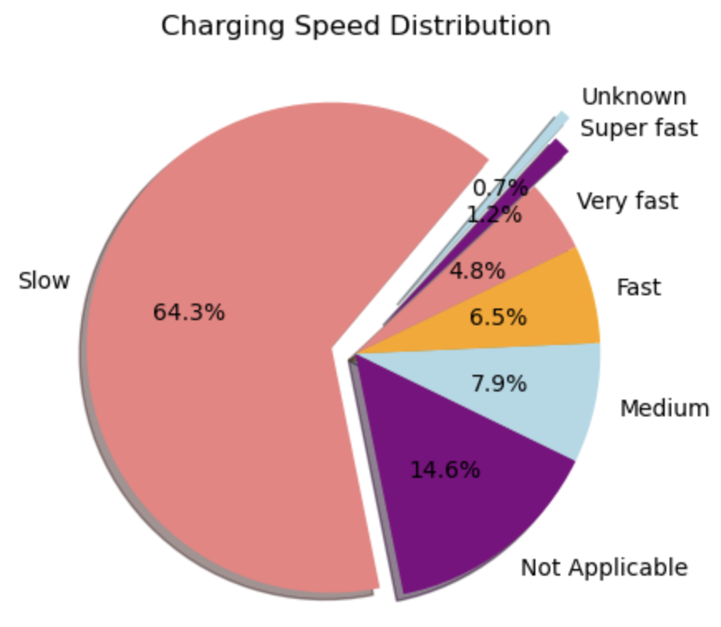
Question 2: What is the ratio of cars to chargers in the selected cities? What is the speed for all the chargers in top 5 cities?

Slide 10
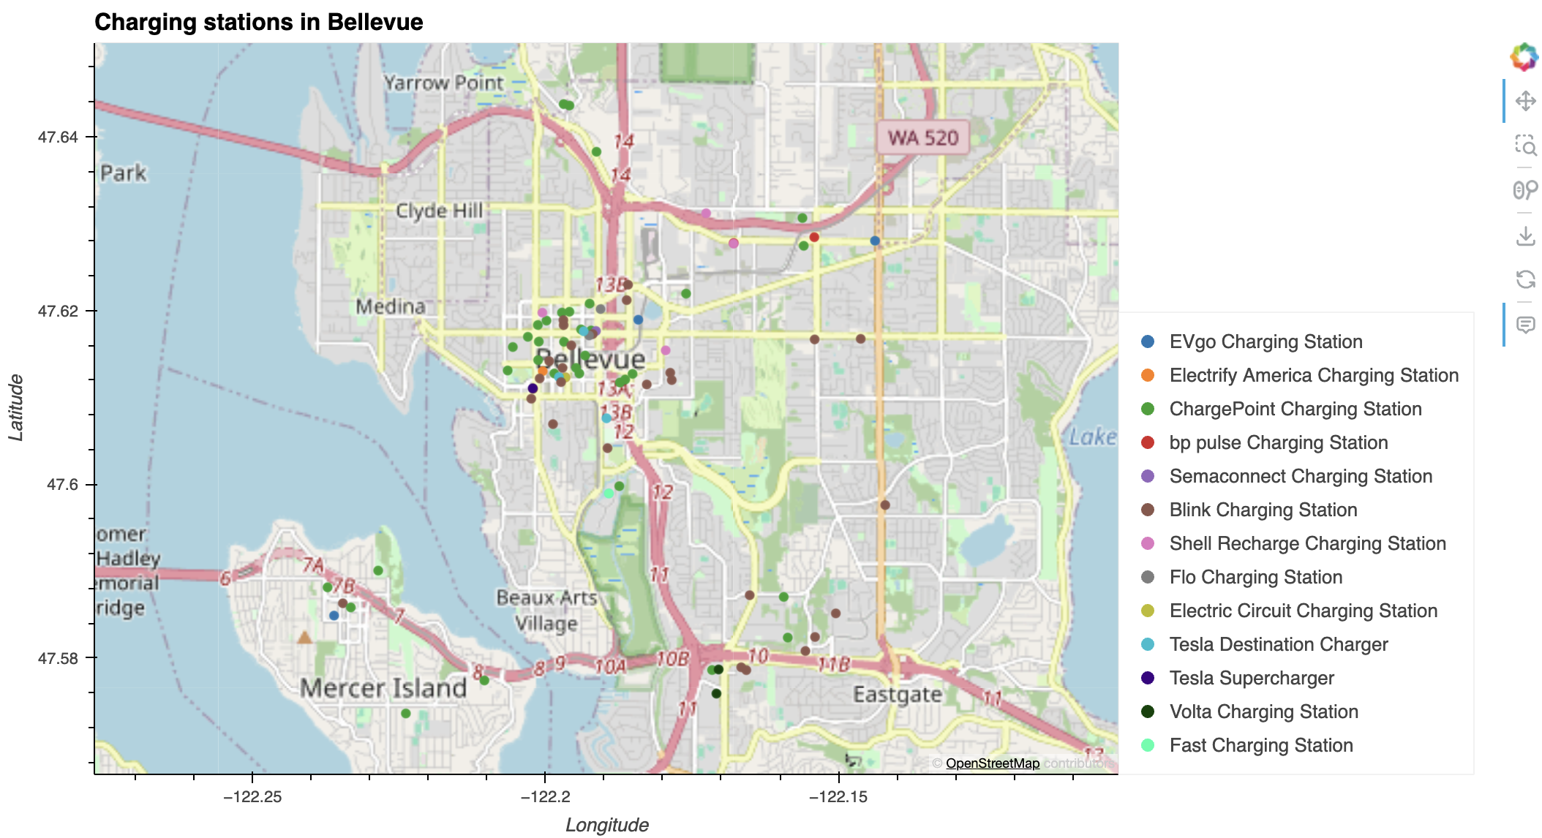
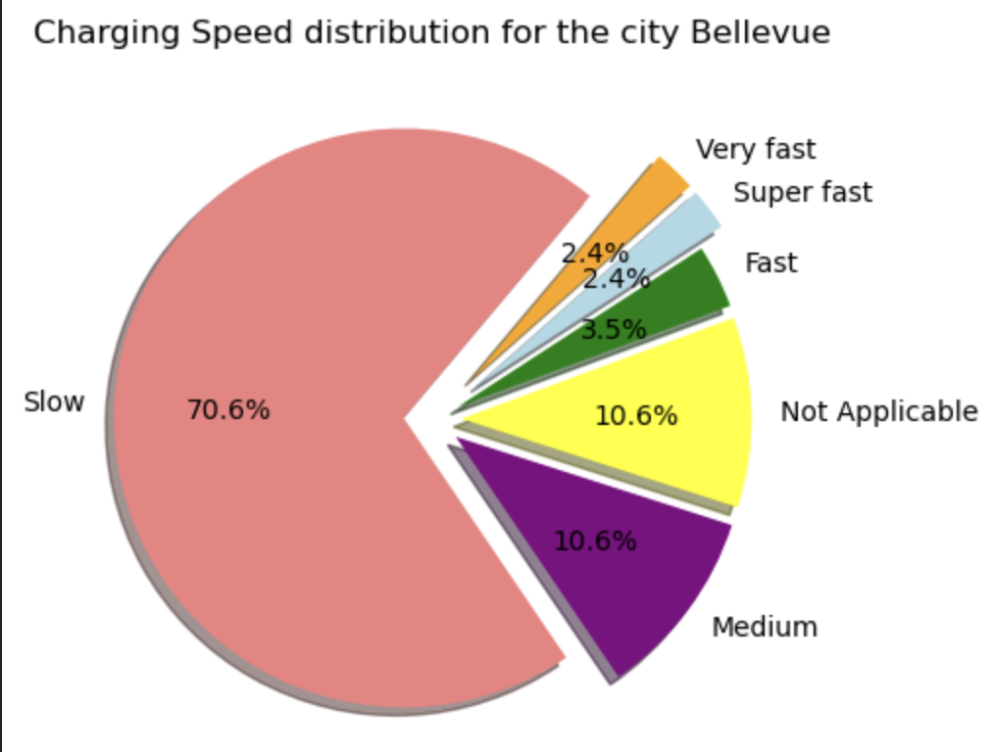
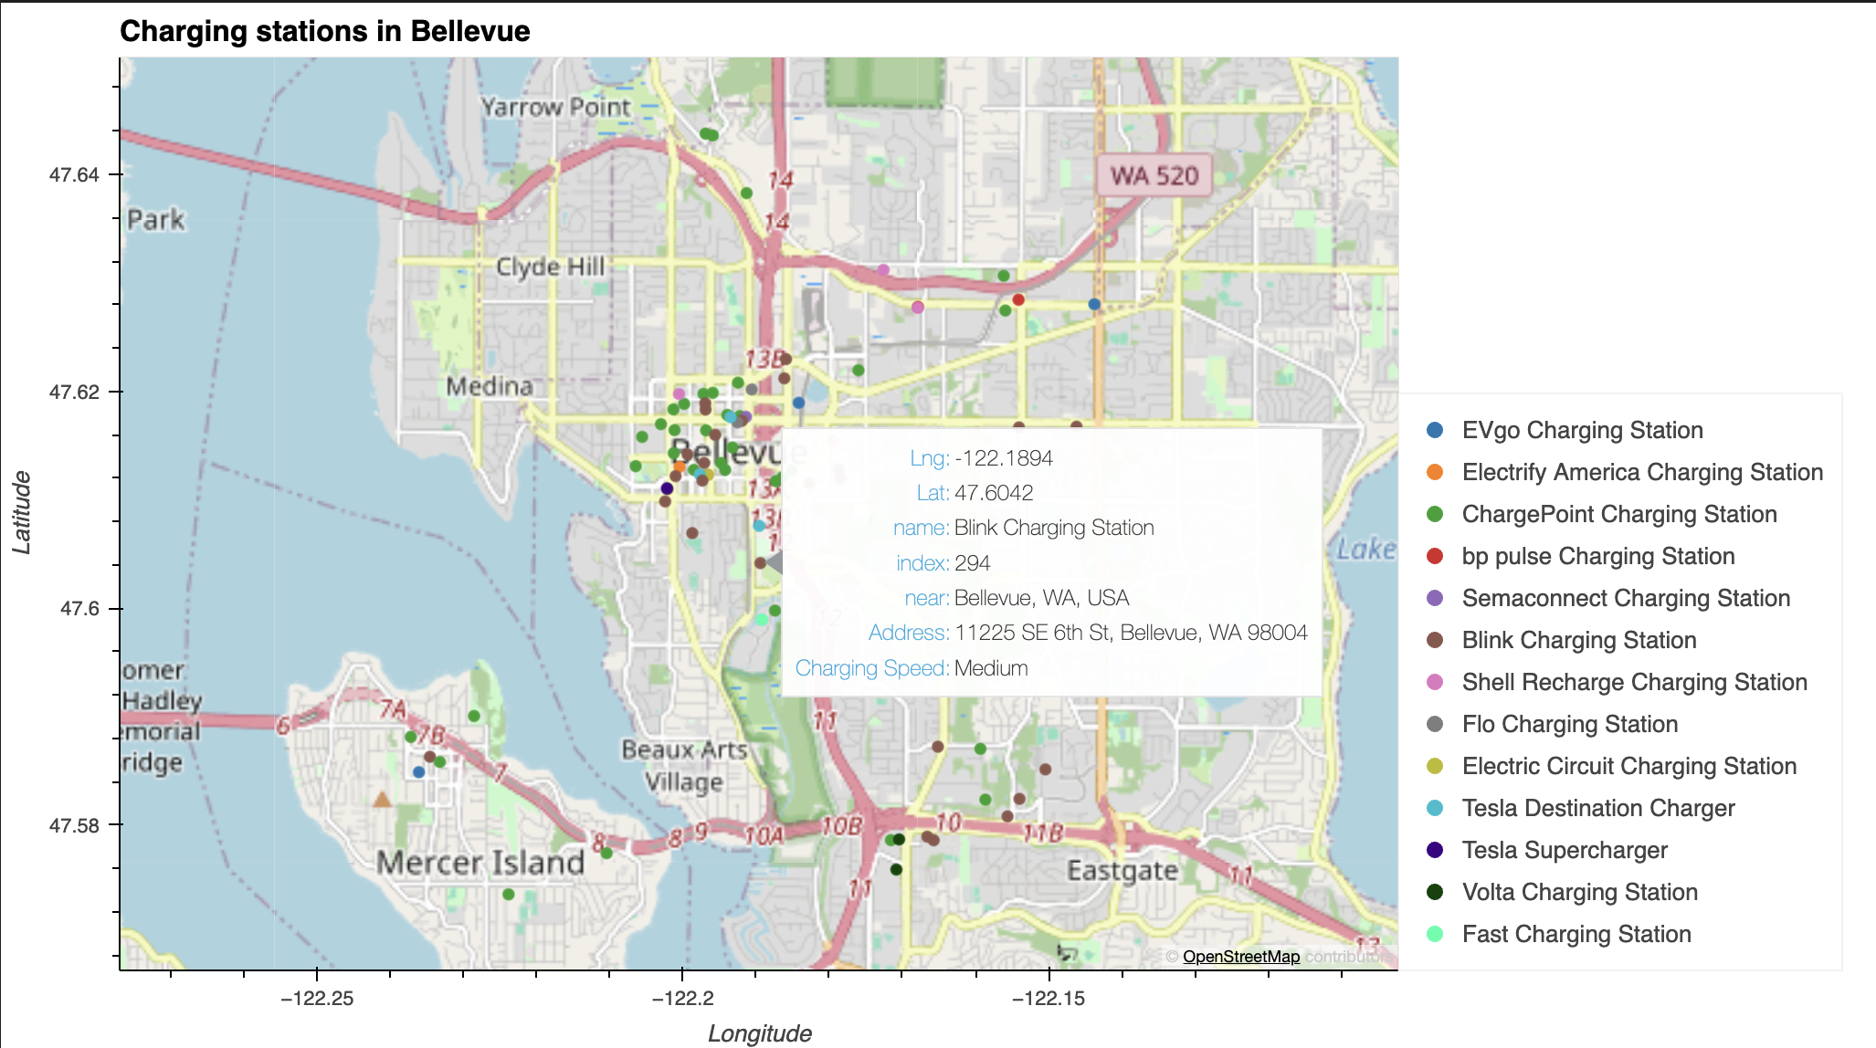
Charging Stations near Bellevue, WA

Slide 11
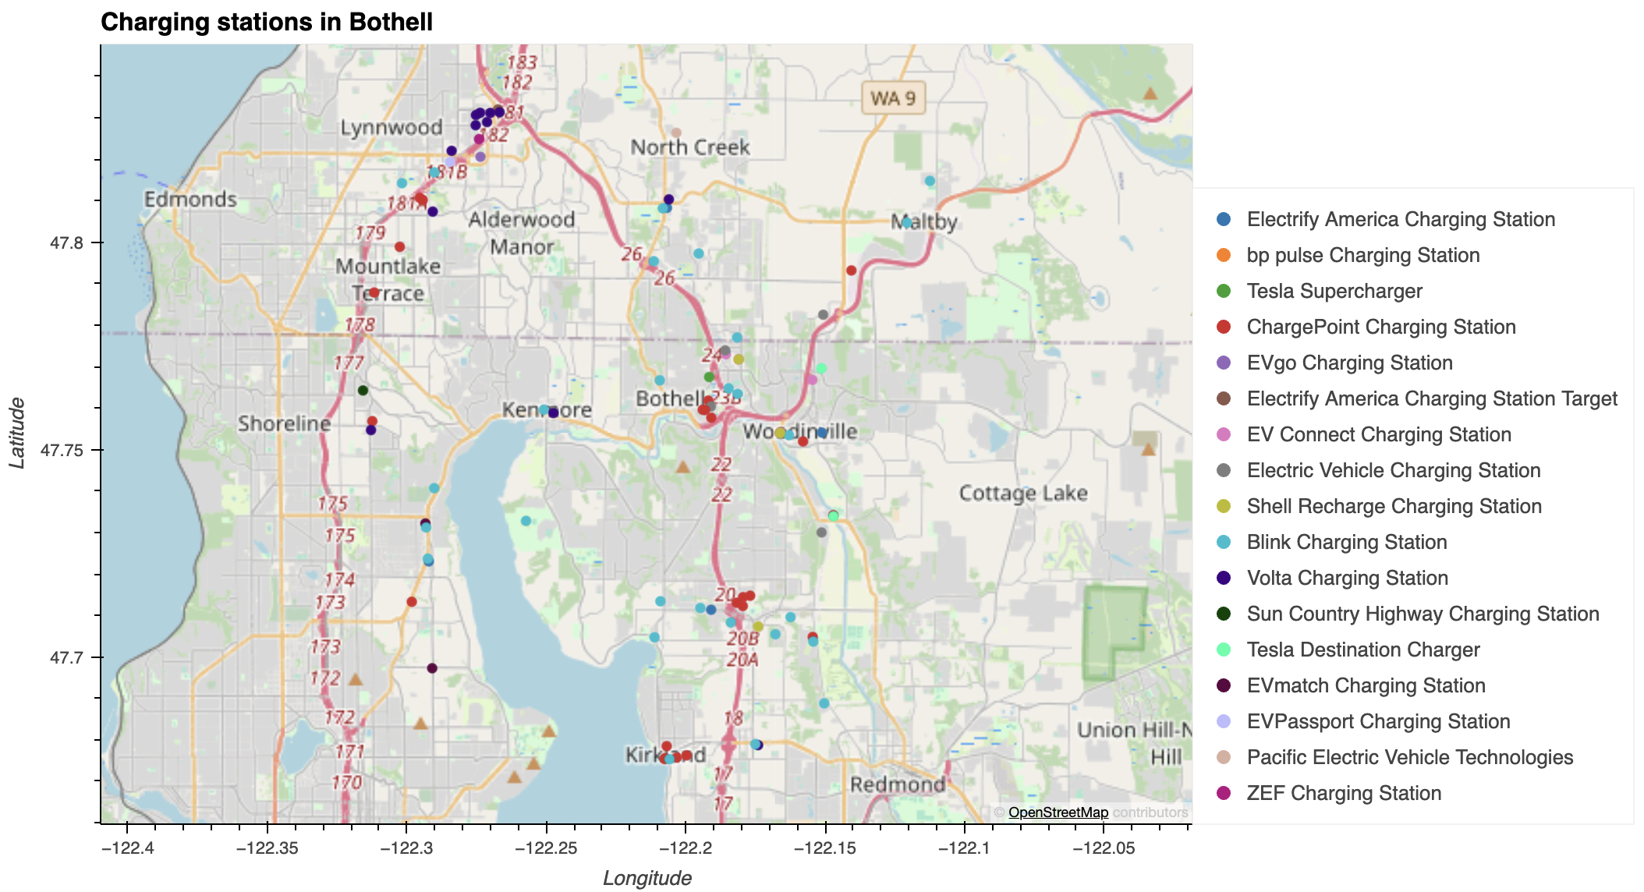
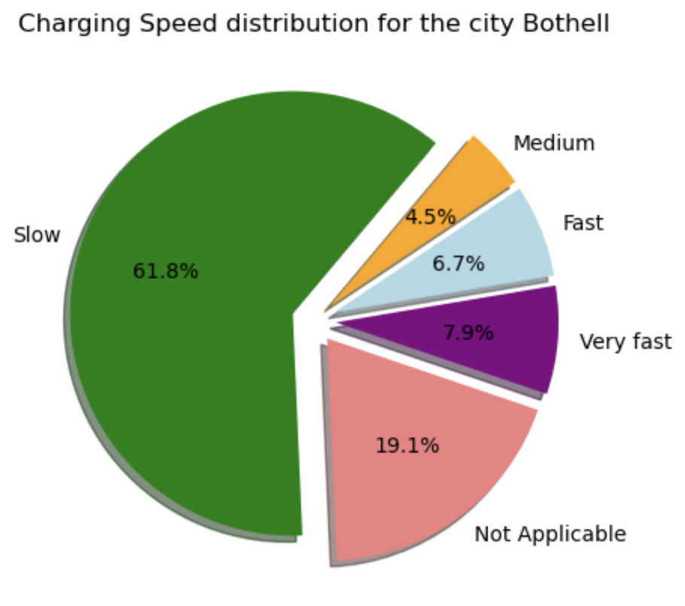
Charging Stations near Bothell, WA

Slide 12
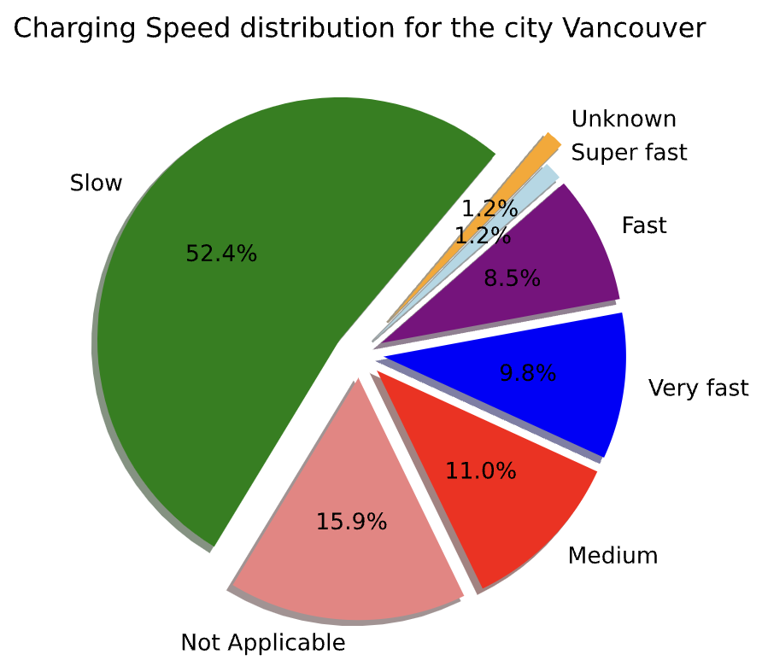
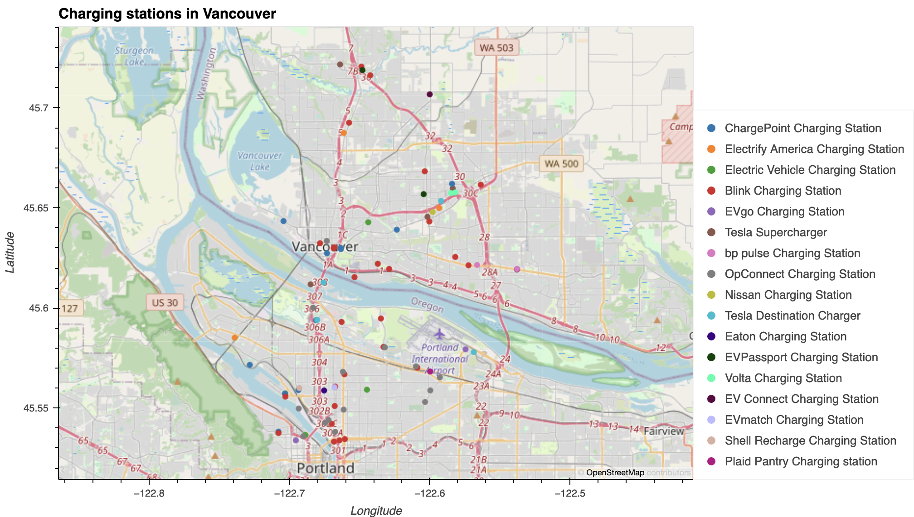
Charging Stations near Vancouver, WA

Slide 13
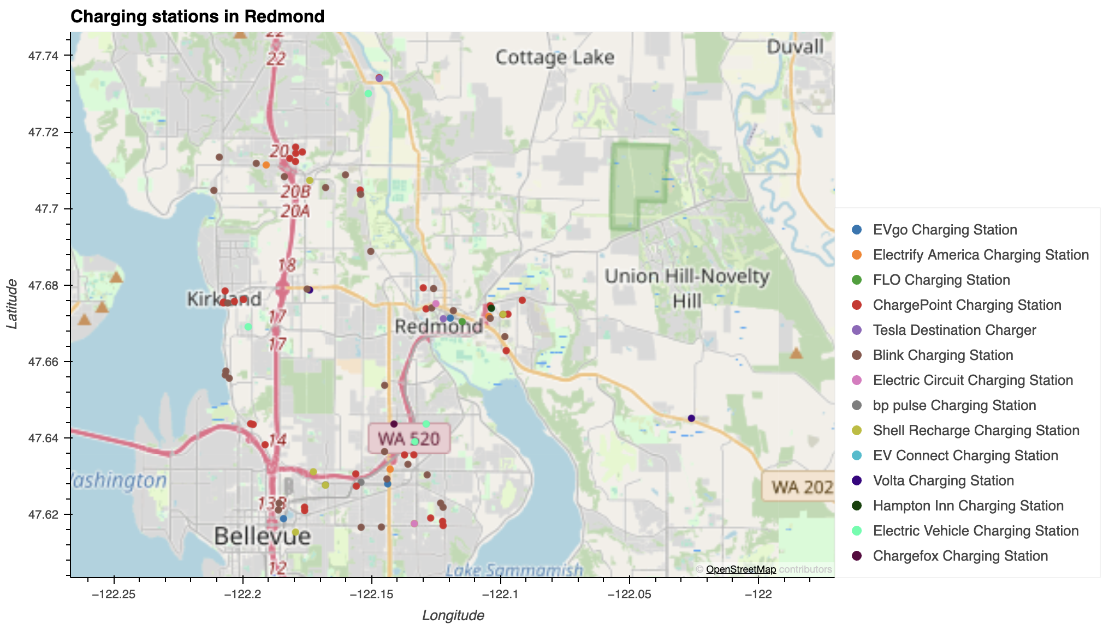
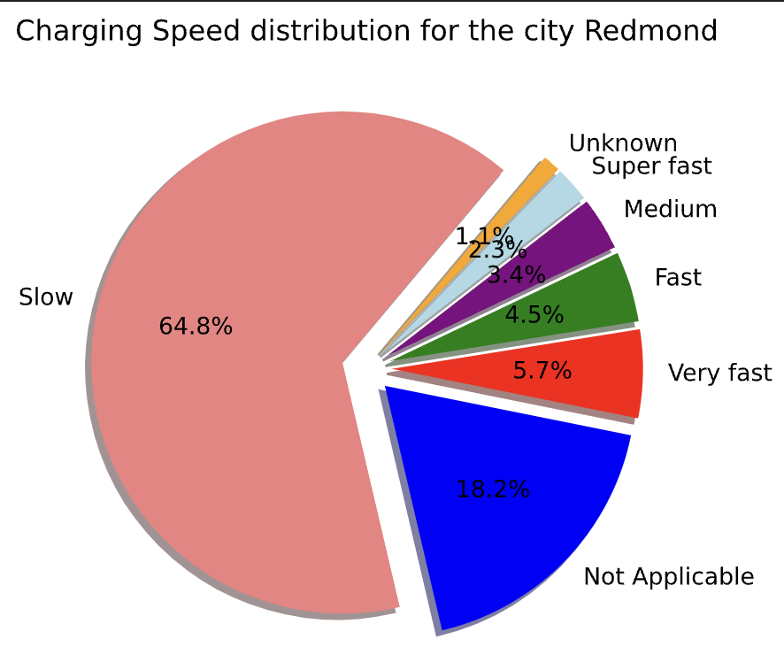
Charging Stations near Redmond, WA

Slide 14
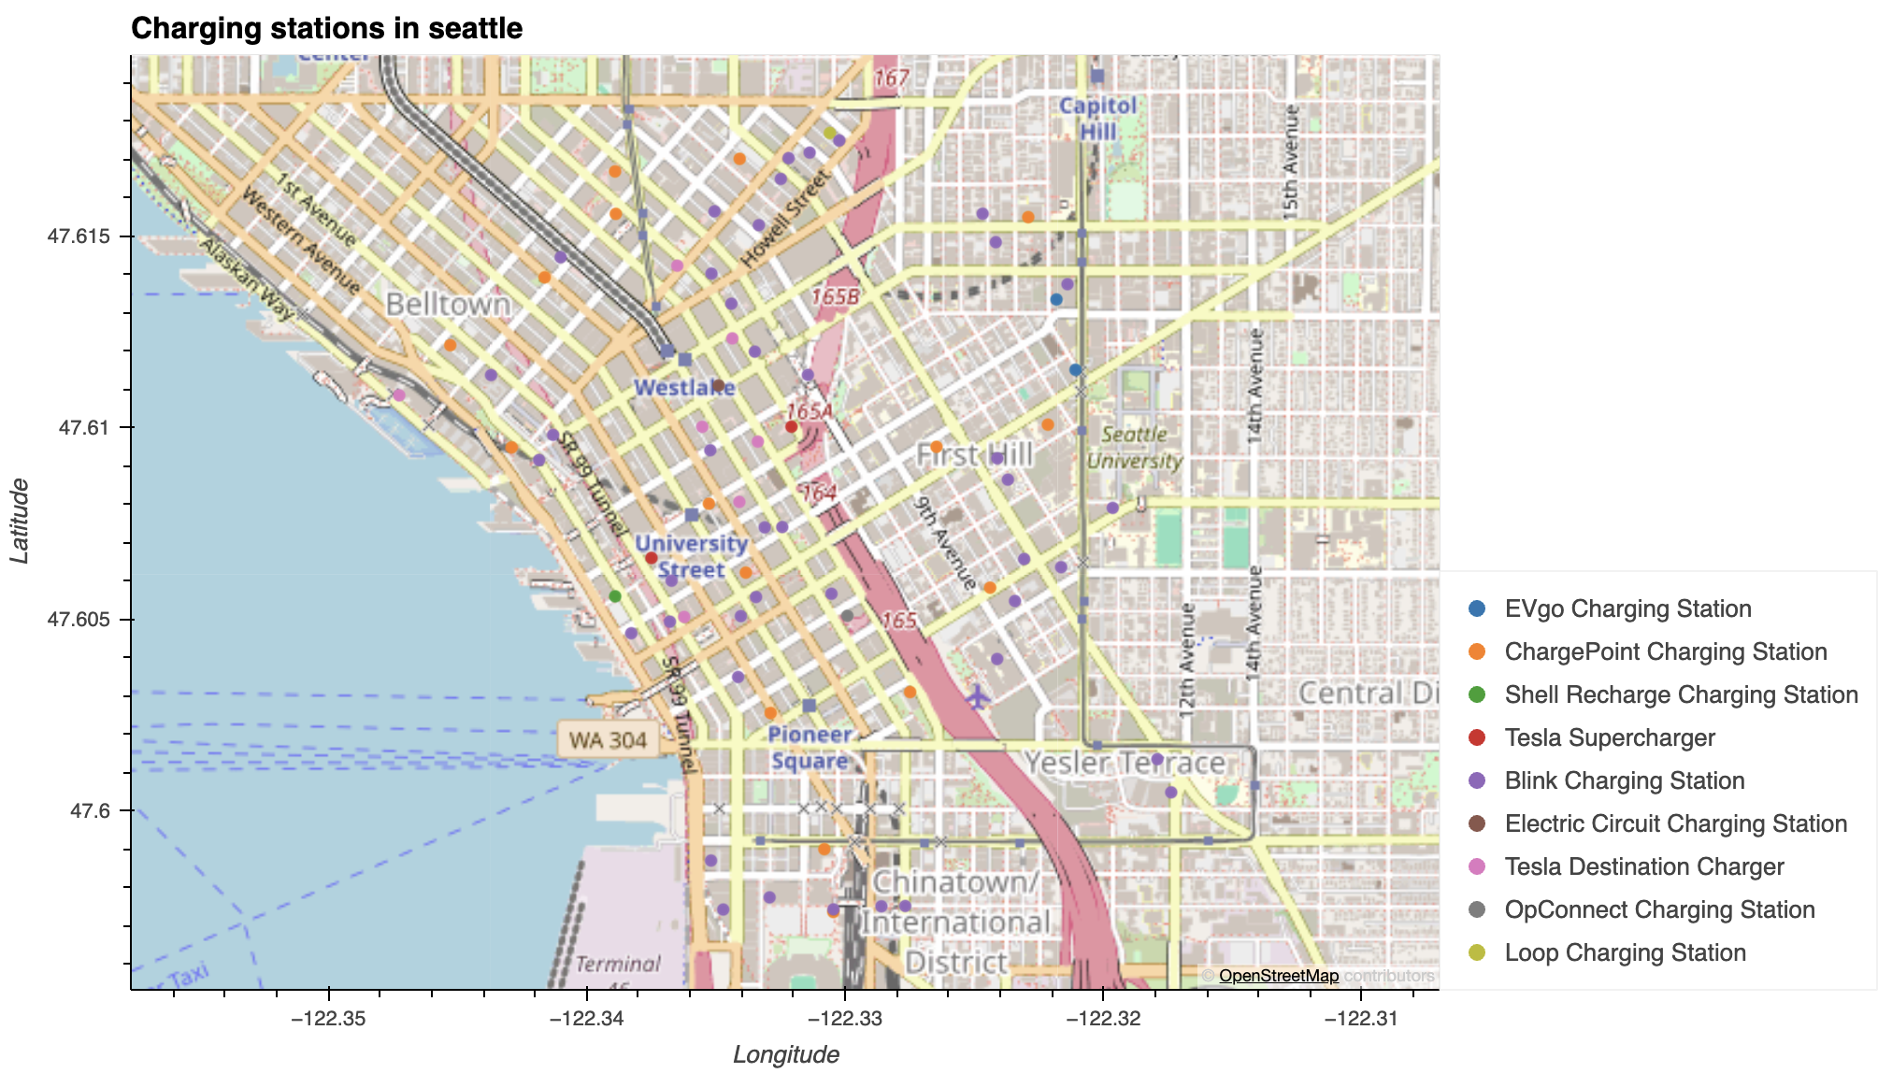
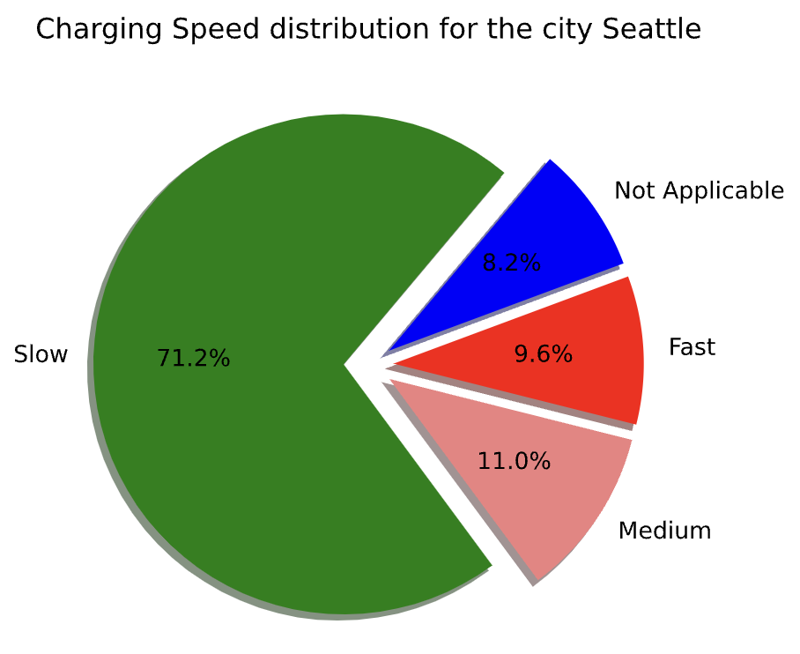
Charging Stations near Seattle, WA

Slide 15
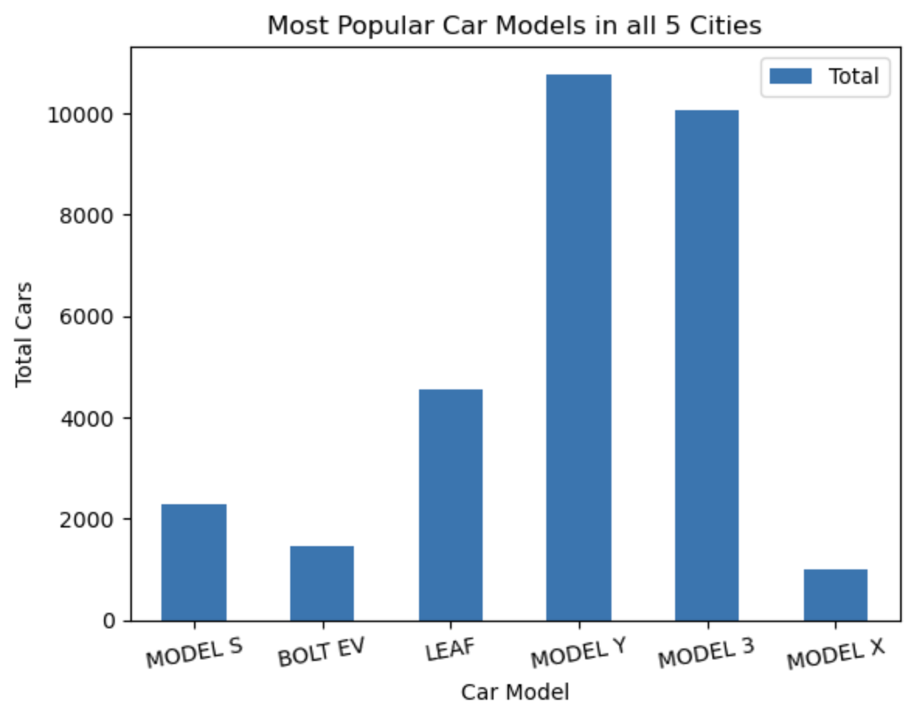
Question 3: What are the top popular car models for all 5 cities?

Slide 16
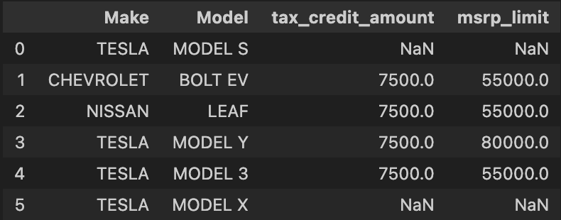
Question 3: What are the most popular car models in the selected cities have federal rebate?
4 out of the 6 most popular car models qualify for federal incentives !!

Slide 17
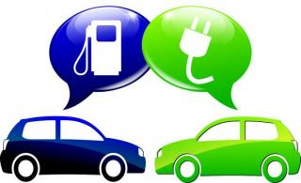
Potential benefits of buying EVs
Grants, Rebates and Tax Credits for new or used EVs & chargers
Electricity Rates more stable than gasoline prices
Availability of chargers near home and workplace
Free or Reduced Tolls
Cheaper to Charge than to
fill the tank
Maintenance Costs are lower, especially with long battery warranties

Slide 18
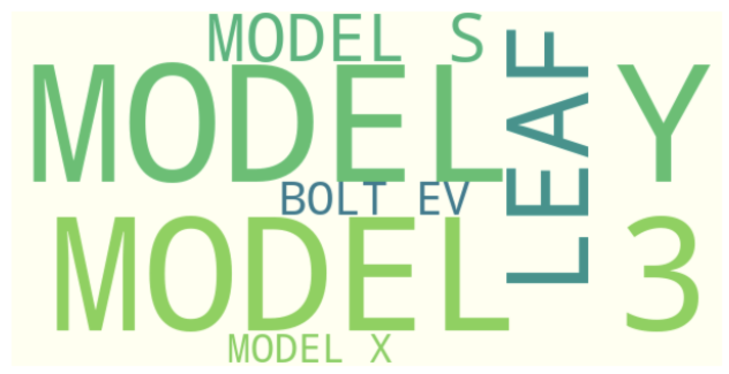
Should you buy an electric car in the state of Washington, USA?
YES!!
Based on the data, one should buy an electric in the state of Washington other than the city of Seattle.
If one is living in Seattle, one should buy a Plug-in Hybrid as there are total 73 charger stations near Seattle of which 52 are slow chargers and there are a total of 26932 EV cars.
TESLA MODEL Y

Slide 19
QUESTIONS

